Slide 1
Speech Emotion Recognition
Notes:
Extract Human Emotions from Audio Files

Slide 2


Problem Statement
We want to participate in the bidding for a Call Centre company for their quality assurance project, one part of this project is to analyse customer interactions, the goal is to detect emotions from the customers and agents. This will help them not only to analyse the customer behaviours but also how agents respond to customer’s emotion.
This project will serve as Proof of Concept, can we detect the 7 emotions from audio file? e.g. Angry, Disgust, Fear, Happy, Neutral, Sad, Surprised
Notes:
Studies of automatic emotion recognition systems aim to create efficient, real-time methods of detecting the emotions of mobile phone users, call center operators and customers, car drivers, pilots, and many other human-machine communication users. Adding emotions to machines has been recognized as a critical factor in making machines appear and act in a human-like manner (André et al., 2004).

Slide 3
Table of contents
01
02
Intro to Sound
Datasets
03
04
Feature Extraction
MODEL

Slide 4
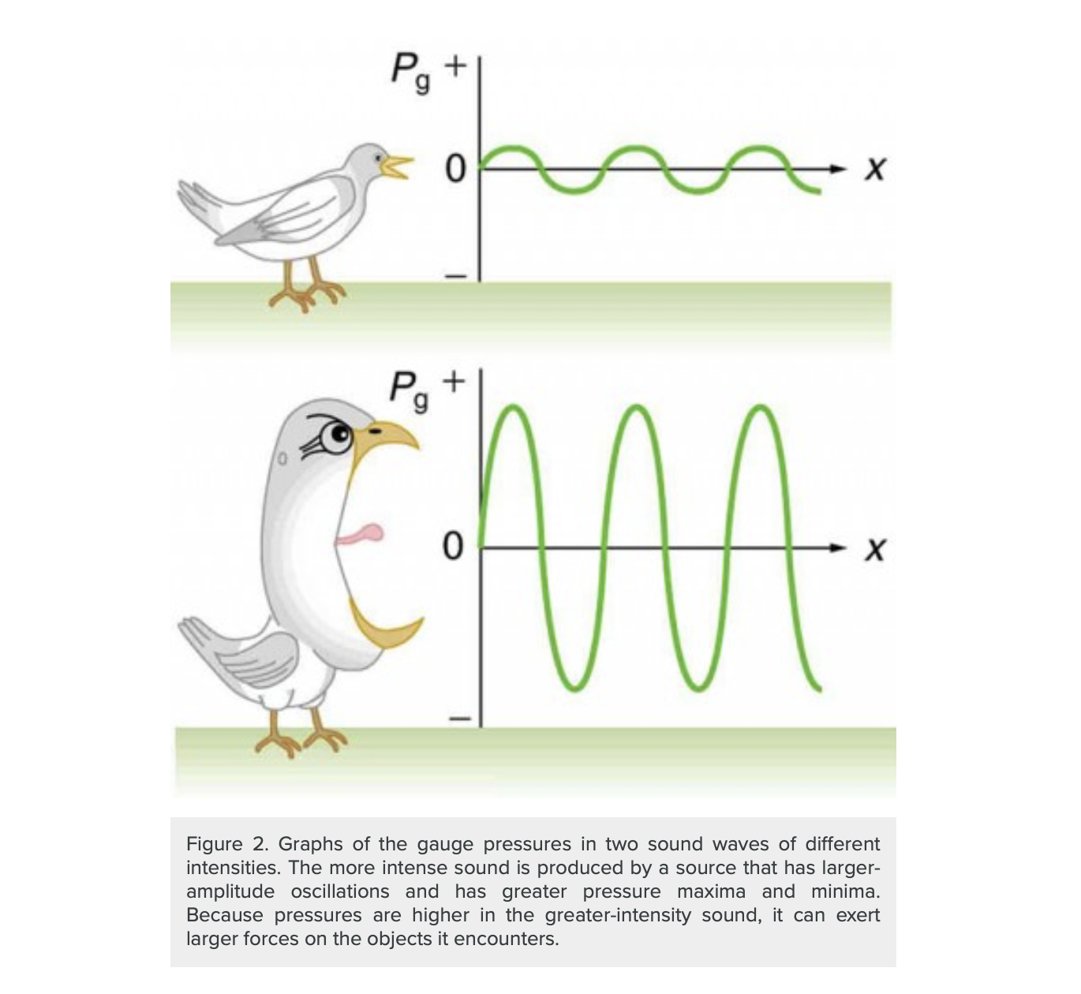
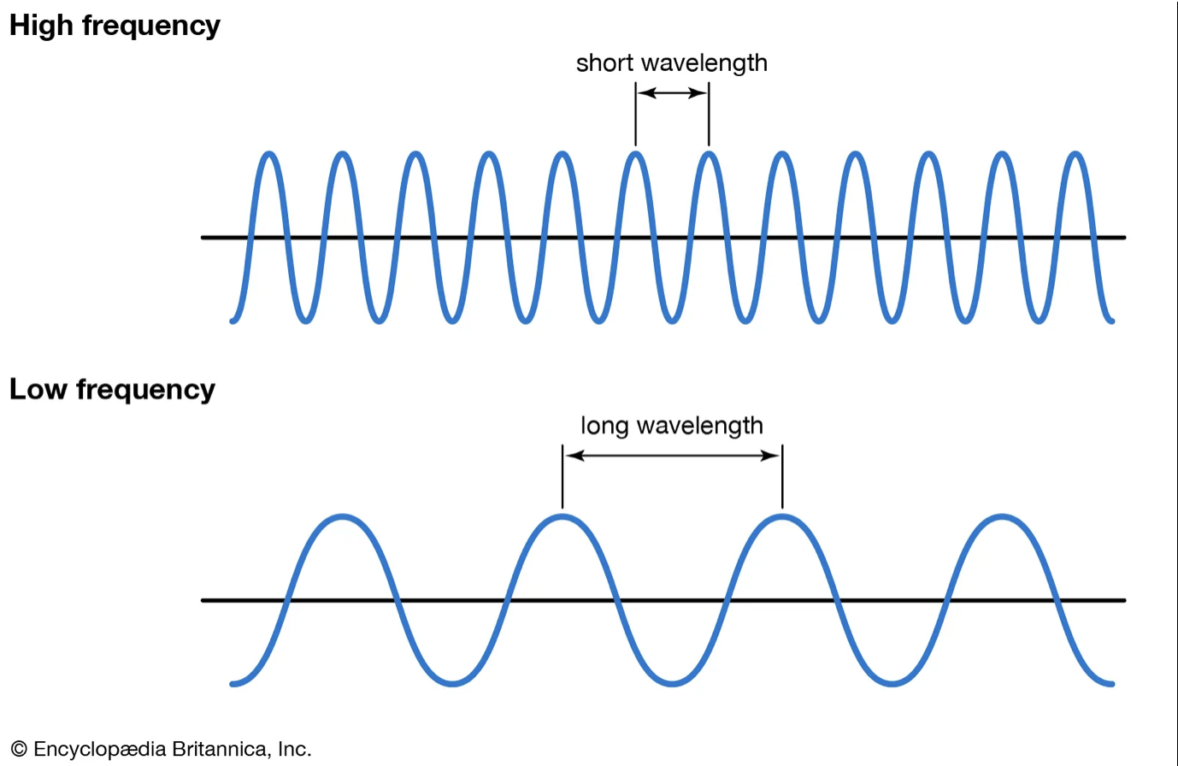
What is sound?
Frequency
AMPLITUDE (Sound Intensity)
Frequency, sometimes referred to as pitch, is the number of times per second that a sound pressure wave repeats itself.
Notes:
What is Sound >> Sound moves through a medium such as air or water as waves. It is measured in terms of frequency and amplitude.
(higher frequency -> higher sound)
The lower the frequency, the fewer the oscillations.
High frequencies produce more oscillations.
Pitch — how high or low a sound is. It depends on frequency, higher pitch is high frequency
>>
Sound intensity levels are quoted in decibels (dB) much more often than sound intensities in watts per meter squared. Decibels are the unit of choice in the scientific literature as well as in the popular media. The reasons for this choice of units are related to how we perceive sounds. How our ears perceive sound can be more accurately described by the logarithm of the intensity rather than directly to the intensity.
(larger amplitude -> louder)

Slide 5
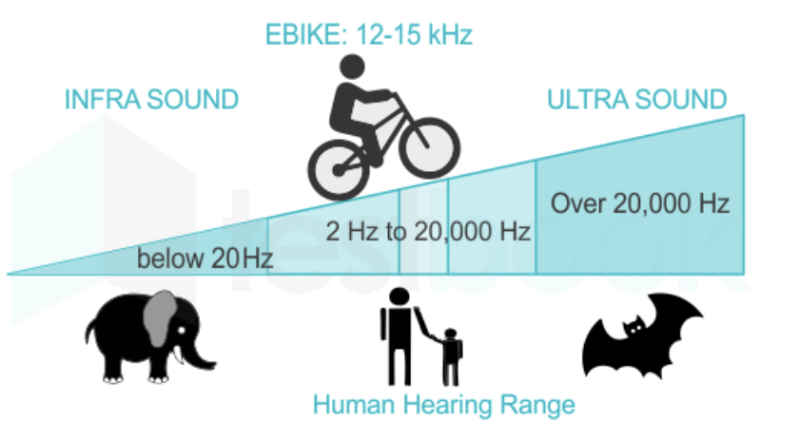
Unit of Frequency
The units of frequency are called hertz (Hz). Humans with normal hearing can hear sounds between 20 Hz and 20,000 Hz. Frequencies above 20,000 Hz are known as ultrasound.
Source: https://selfstudy365.com/qa/the-frequency-range-for-hearing-the-sound-by-a-human-ear-is-in-the-ran-5eee3cb408665507c5926a6c

Slide 6
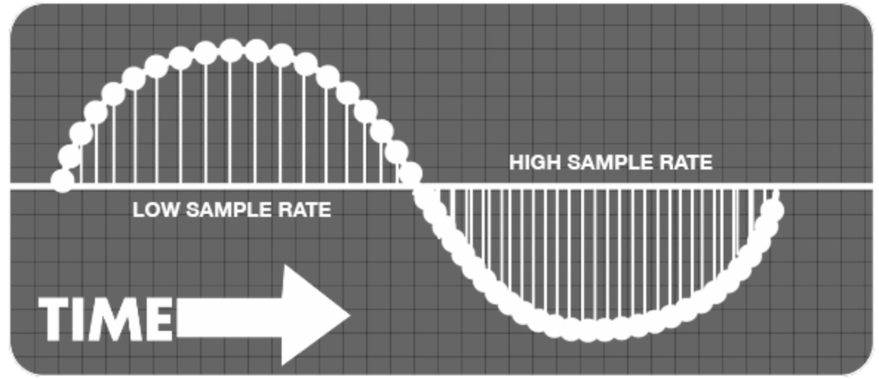
sample rates
https://homestudiorecordings.com/sample-rate-bit-depth/
Notes:
When you’re trying to sample audio from an analogue source, a calculation takes place inside the computer. The calculation converts the analogue sounds of a guitar, keyboard or other instrument into digital data. Sample rate is key to the quality of this conversion.
Audio sampling is the process of transforming a musical source into a digital file. Digital audio recording does this by taking samples of the audio source along the soundwaves at regular intervals. The more samples you take - known as the ‘sample rate’ - the more closely the final digital file will resemble the original. A higher sample rate tends to deliver a better-quality audio reproduction.
https://www.adobe.com/sg/creativecloud/video/discover/audio-sampling.html

Slide 7
02
The Datasets

Slide 8
3 Datasets
RAVDESS
SAVEE
TESS
The Ryerson Audio-Visual Database of Emotional Speech and Song (RAVDESS)
Surrey Audio-Visual Expressed Emotion (SAVEE)Database
Toronto emotional speech set (TESS)
References:
https://zenodo.org/record/1188976#.YmlBpS8RoTs
https://tspace.library.utoronto.ca/handle/1807/24487
http://personal.ee.surrey.ac.uk/Personal/P.Jackson/SAVEE/Database.html

Slide 9
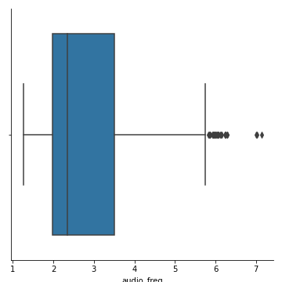
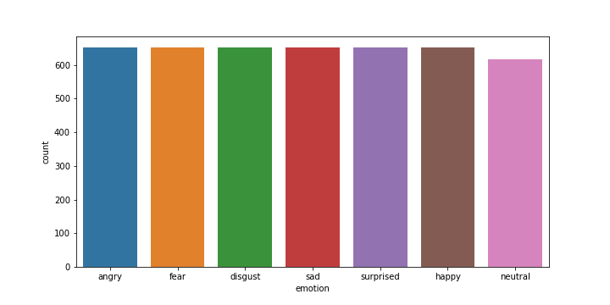
Sample RATE: 22050 Hz
7 emotions
Notes:
Average audio length: 2.5 s
4,528 samples

Slide 10








RAVDESS
SAVEE
TESS

Slide 11
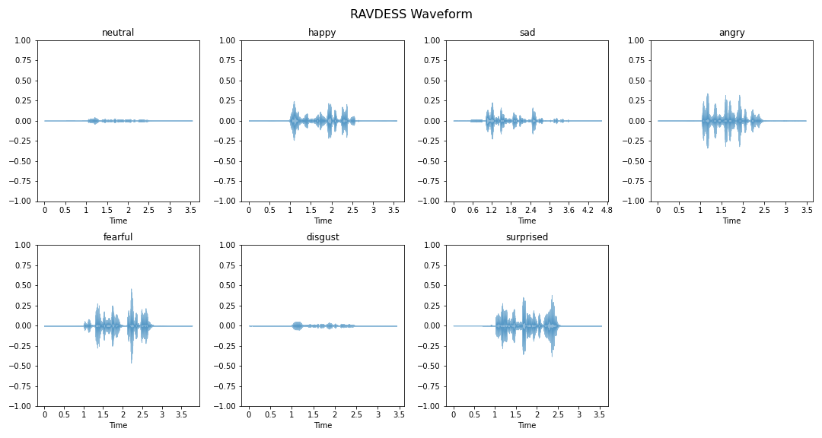
WAVEFORM - RAVDESS
Notes:
Visualize a waveform in the time domain
What is waveform?
High Amplitude: Happy, angry fear

Slide 12
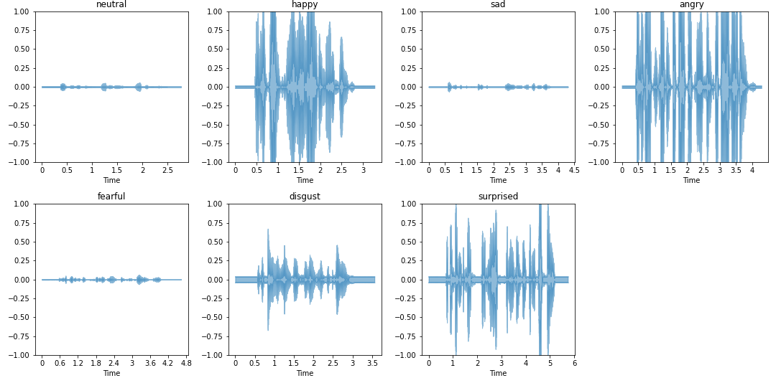
WAVEFORM - SAVEE
Return
Notes:
High Amplitude: Happy, angry and surprised

Slide 13
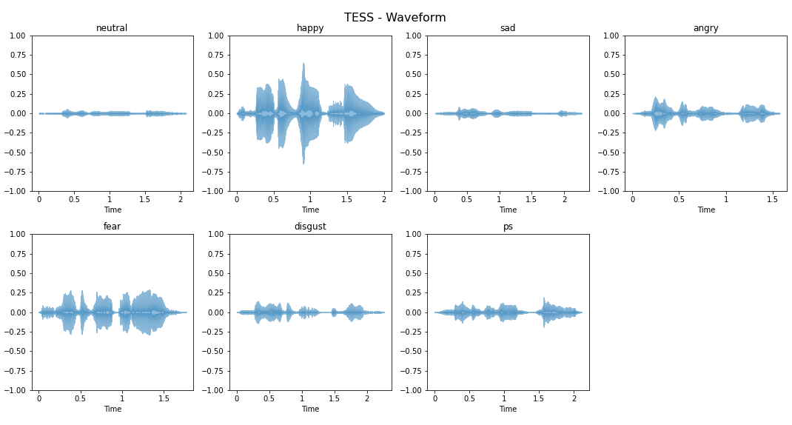
WAVEFORM - TESS
Return
Notes:
High Amplitude: Happy, fear

Slide 14

03
Audio features

Slide 15
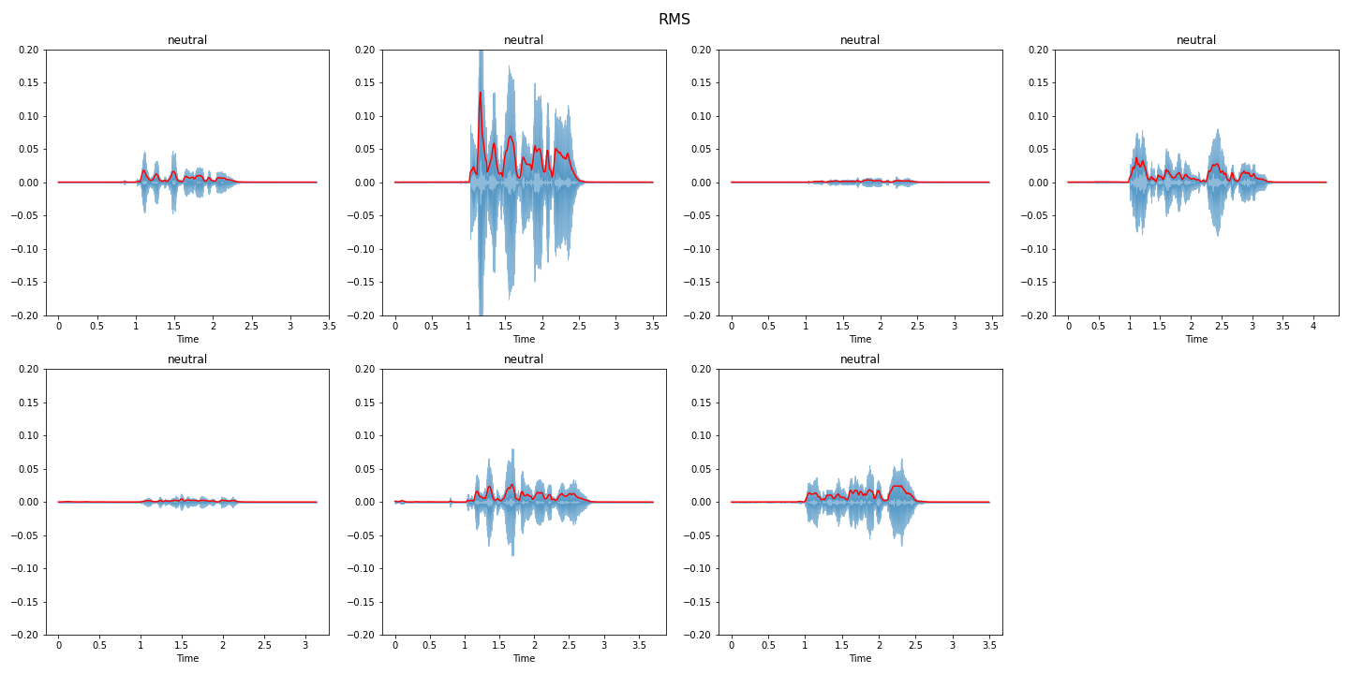
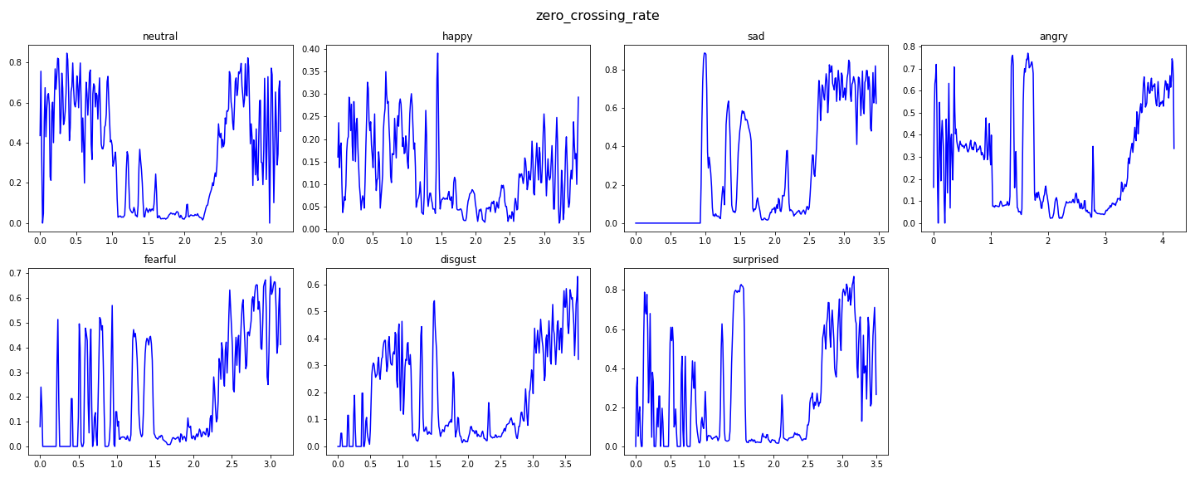
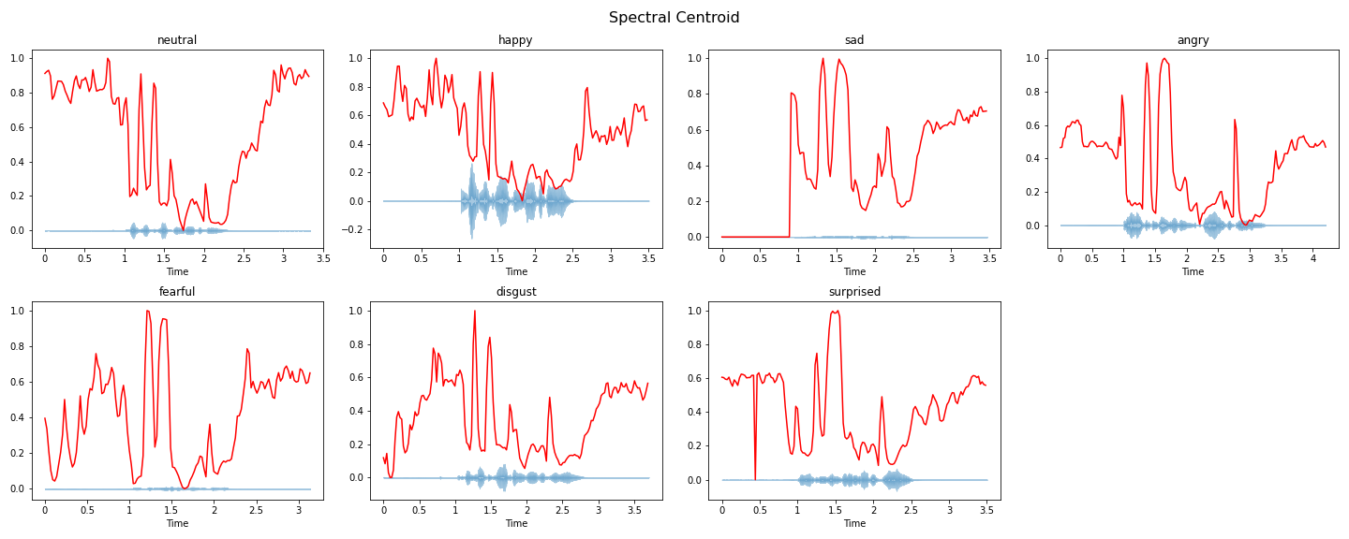
ROOT MEAN SQUARE
Zero Crossing RATE
Spectral CENTROID

Slide 16
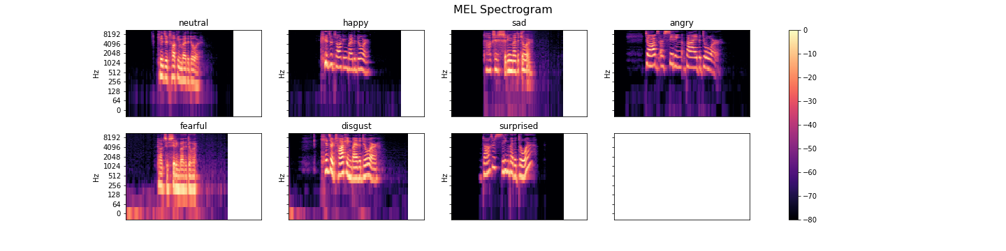
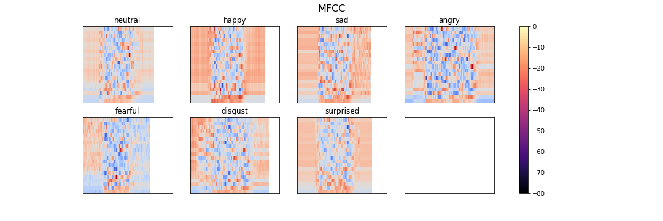

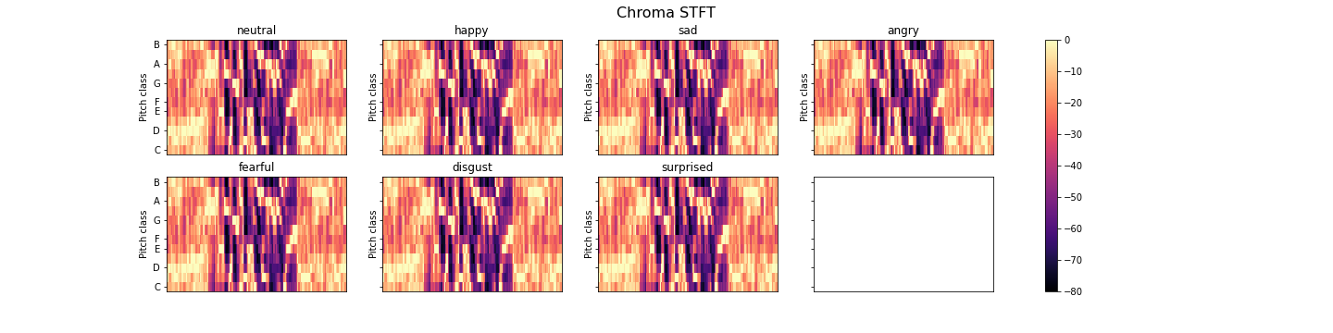
MEL-SPECTOGRAM
MFCC
Chroma STFT
Notes:
Spectogram
Mel scale — deals with human perception of frequency, it is a scale of pitches judged by listeners to be equal distance from each other

Slide 17
DATA AUGMENTATION

Slide 18
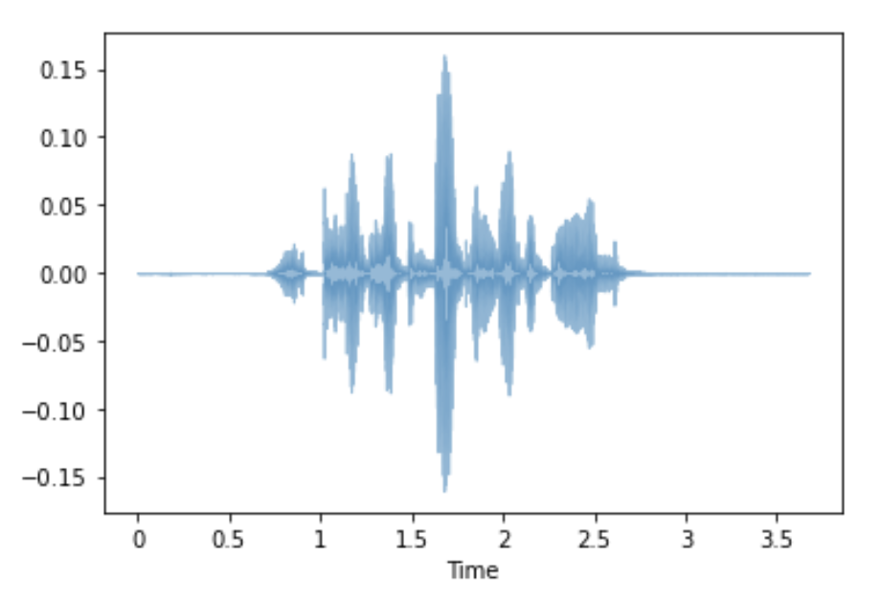
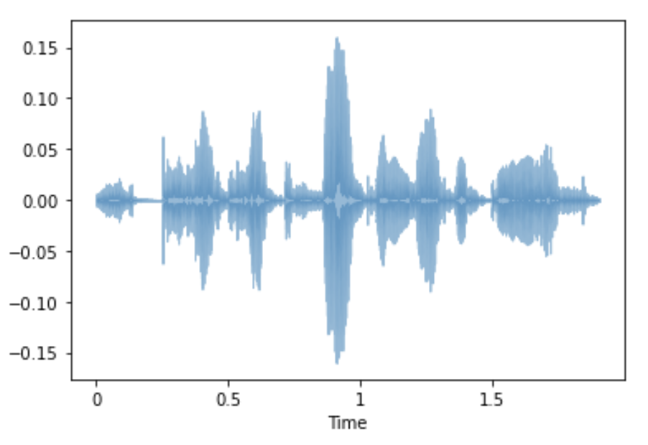
Trimming
TRIM

Slide 19
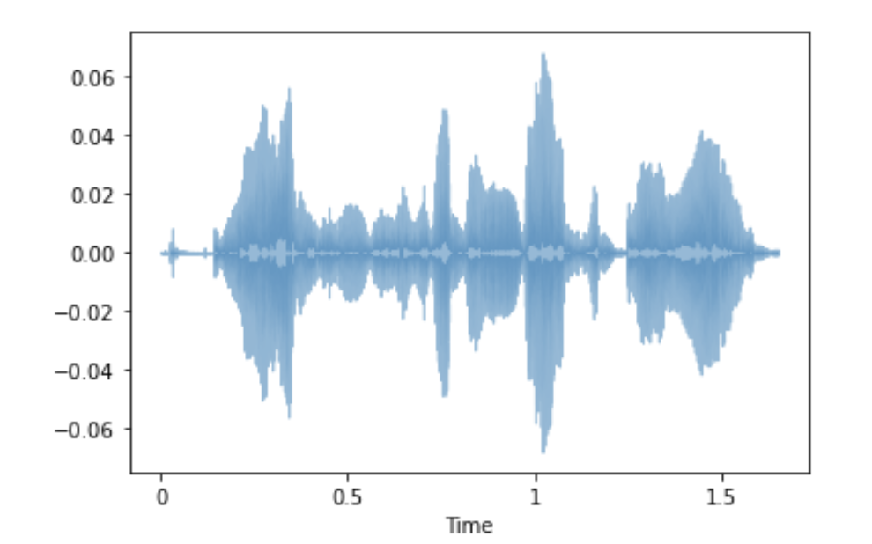
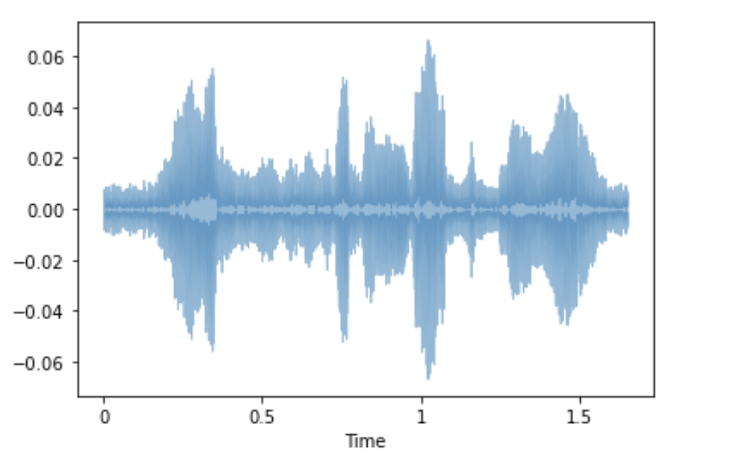
ADDING Noise
Noise

Slide 20
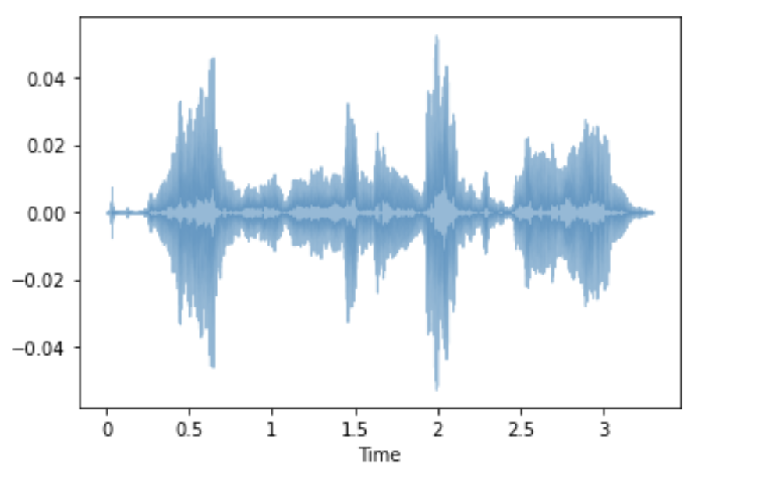
STRETCHING
Stretch

Slide 21
04 MODEL

Slide 22
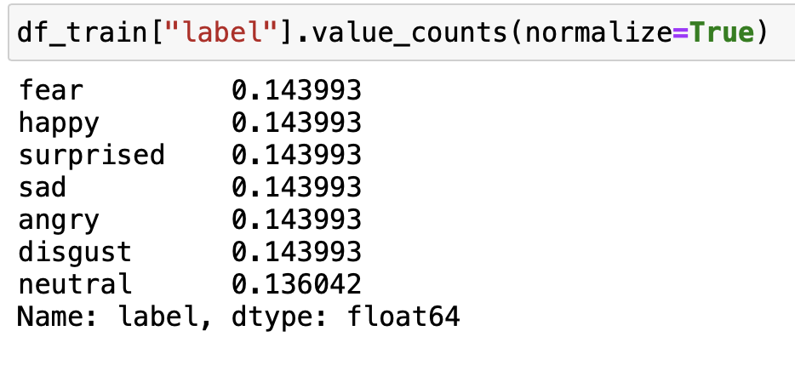
Base MODEL – 14%
Notes:
Optuna is automatic hyperparameter tuning framework
MLPClassifier stands for Multi-layer Perceptron classifier which in the name itself connects to a Neural Network. Unlike other classification algorithms such as Support Vectors or Naive Bayes Classifier, MLPClassifier relies on an underlying Neural Network to perform the task of classificationk that is completely written in Python.

Slide 23
184 Features, 7 Target emotions
RMS ZCR Spectral Centroid/ROLLOF
1.8%
6.5%
21.7%
70%
Chroma STFT
MFCC
MEL SPECTOGRAM

Slide 24
TRAIN TEST SPLIT (4,528 samples)
TRAIN: 75%
Original: 3,396
w/ Noise: 3,396
Change of Pitch: 3,396
Total: 10,188
TEST: 25%
1,132

Slide 25
Accuracy
 | *Random Forest | *MLP Classifier | *Voting Classifier | TF – CONV1d
TRAIN | 100% | 100% | 100% | 100%
TEST | 83% | 88% | 89% | 90%
*Best Parameters using Optuna
Notes:
Optuna is automatic hyperparameter tuning framework
MLPClassifier stands for Multi-layer Perceptron classifier which in the name itself connects to a Neural Network. Unlike other classification algorithms such as Support Vectors or Naive Bayes Classifier, MLPClassifier relies on an underlying Neural Network to perform the task of classificationk that is completely written in Python.

Slide 26
CONV1D
Input
CONV1D (256)
CONV1D (128)
CONV1D (256)
CONV1D (64)
Batch Normalization
CONV1D (64)
Batch Normalization
Batch Normalization
Batch Normalization
RELU
Batch Normalization
RELU
RELU
RELU
Flatten
CONV1D (128)
RELU
Dropout
Batch Normalization
Output
Average Pooling1D
RELU
Average Pooling1D

Slide 27
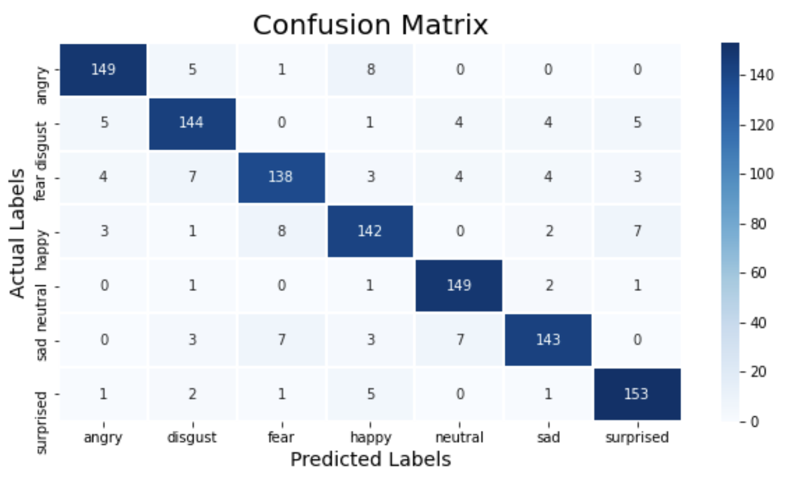
DEEP LEARNING (Conv1D)
 | F1 Score
Angry | 92%
Disgust | 88%
Fear | 87%
Happy | 87%
Neutral | 94%
Sad | 90%
Surprised | 92%
Link to: Sample wave form

Slide 28
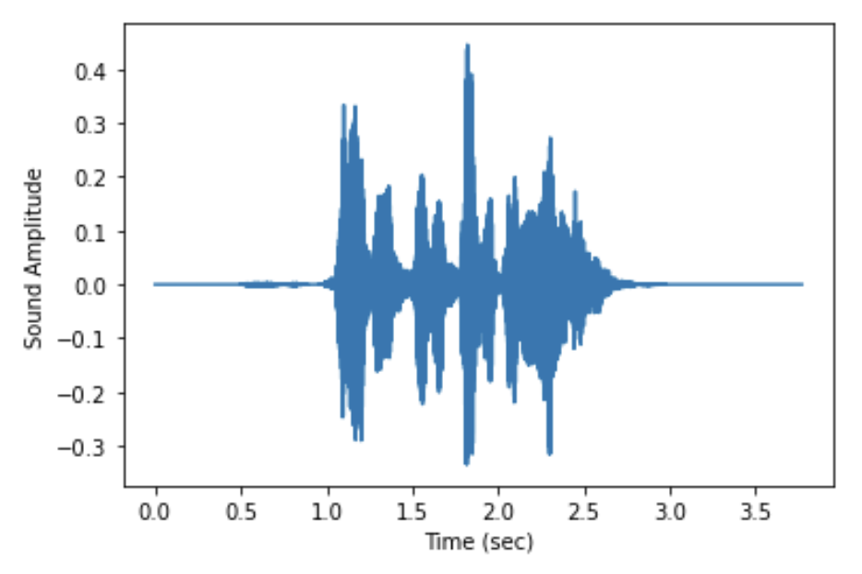
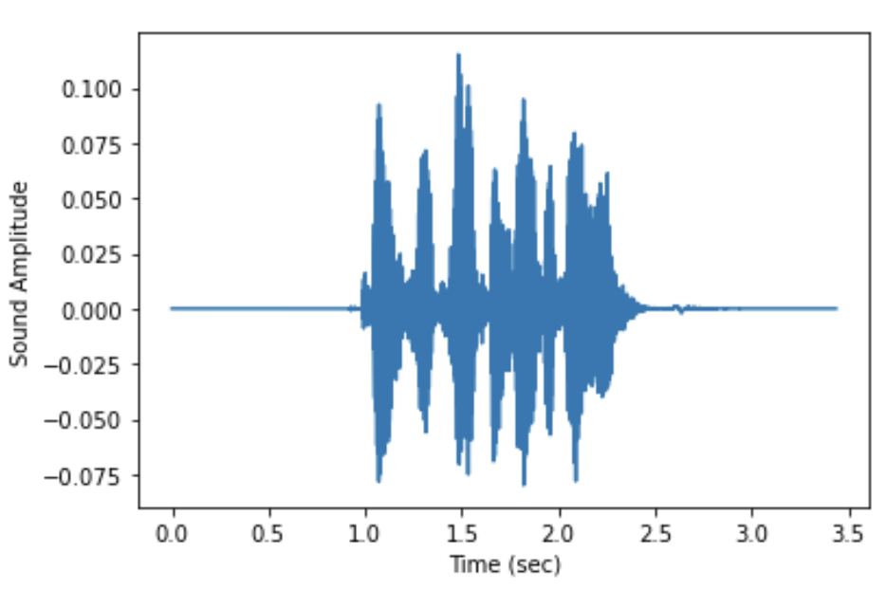
misclassified emotions
Actual is [happy] Predicted as [fear]
Actual is [surprised] Predicted as [happy]

Slide 29
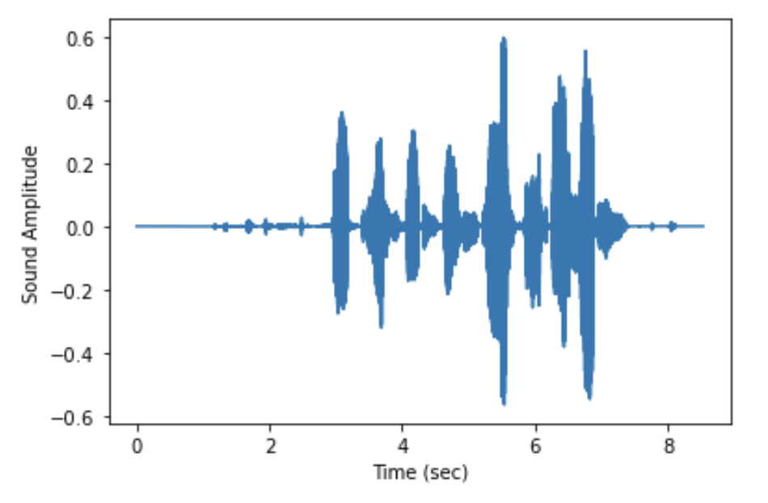
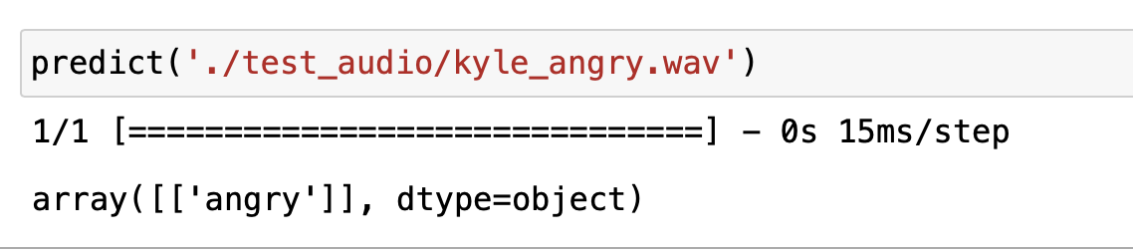
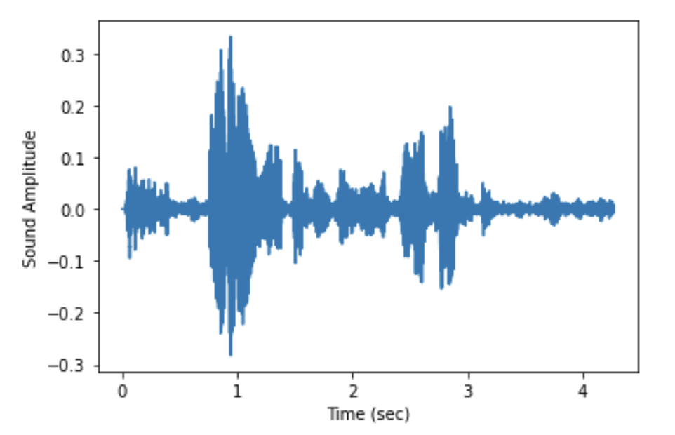
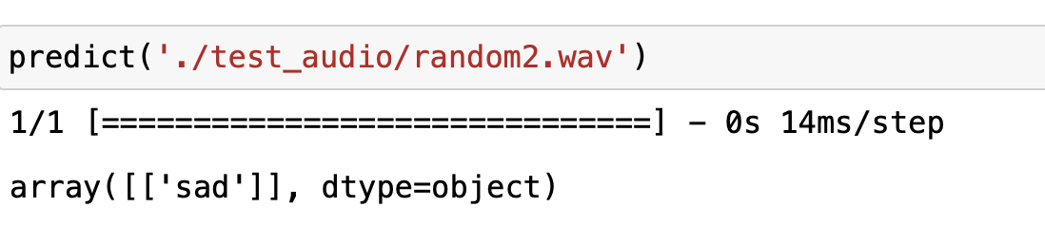
PREDICT from actual recordings

Slide 30
RECOMMENDATIONS
There are a lot more features from Librosa that were not included in the model, we can further analyze which features can help in getting better prediction.
For enhancement, this can be a two-step model,
where we identify the gender first, then the emotions.

Slide 31
THANKS!
Do you have any questions?
carinarebellon@outlook.com
+65 9855 1334
Please keep this slide for attribution

Slide 32


